Slide 1


LOGO
Username
Password
Log In
Forgot Password?
Create a new account
First Name
Last Name
Male
Female
Official Email Id
Phone Number
Enter Password
Re-enter Password
* Terms and conditions
Register
About Helfis Blog Contact Us FAQs Terms

Slide 2

LOGO
Hi Name
Psychometric Assessment
Take the data from the google form

Slide 3
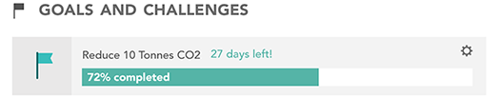
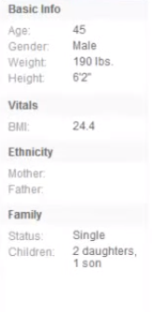
LOGO
Hi Name
Profile Picture
Name
Your Activities
Basic Info
Health Conditions
Family History
Lifestyle & Diet
Update

Slide 4
LOGO
Hi Name
Account Settings
Username
Phone Number
Company Email Id
Google Account
Show your performance to others
Yes/No
Update

Slide 5
LOGO
Hi Name
Next Screen On slide 5, if clicked
Profile
Next Screen On slide 6, if clicked
Your Bookings
May 2, 2017 3:30-4:30 Yoga Class
May 3, 2017 2:30-3:30 Dance Class
Make a new appointment
Rewards
Points Accumulated Charity
450coins INR 300/- till date
Account Settings
Logout
Next Screen On slide 3, if clicked
Today’s Diet Plan
Breakfast
Askljalsdj
Lunch
Alksjdlkjas
Dinner
alksjdlkasjd
The ‘Fit’ You!!
Height Weight BMI BMR
Muscle Mass Body Fat Water Visceral Fat Bone
Psychometric Report
Next Screen On slide 4, if clicked
Health Quote
An apple a day keeps the doctor away.
Health Blog
An apple a day keeps the doctor away.. Read more..
About Helfis Blog Contact Us FAQs Terms

Slide 6
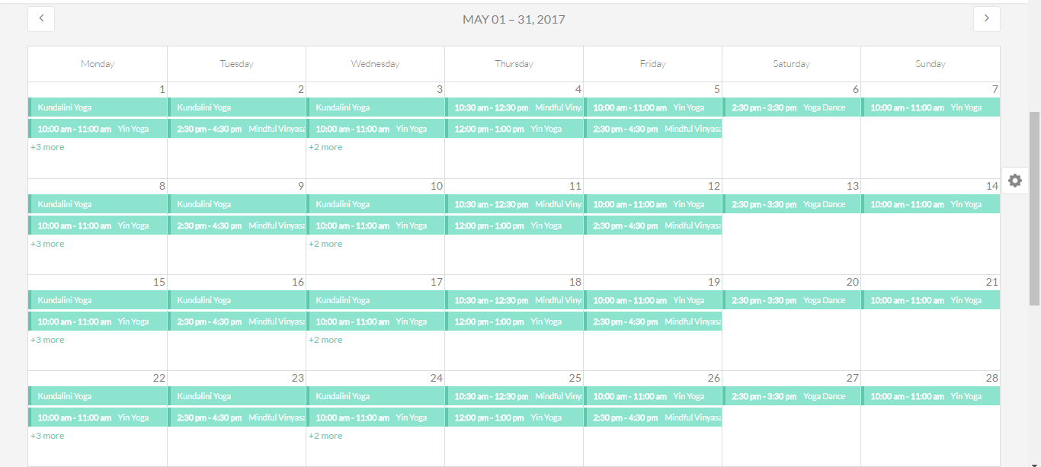
LOGO
Hi Name
- Add an option where a person can choose to see the calendar day wise, week wise and month wise
- Person can make a booking accordingly, seeing the plan

Slide 7
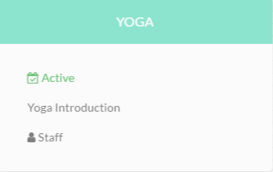
LOGO
Hi Name

Slide 8
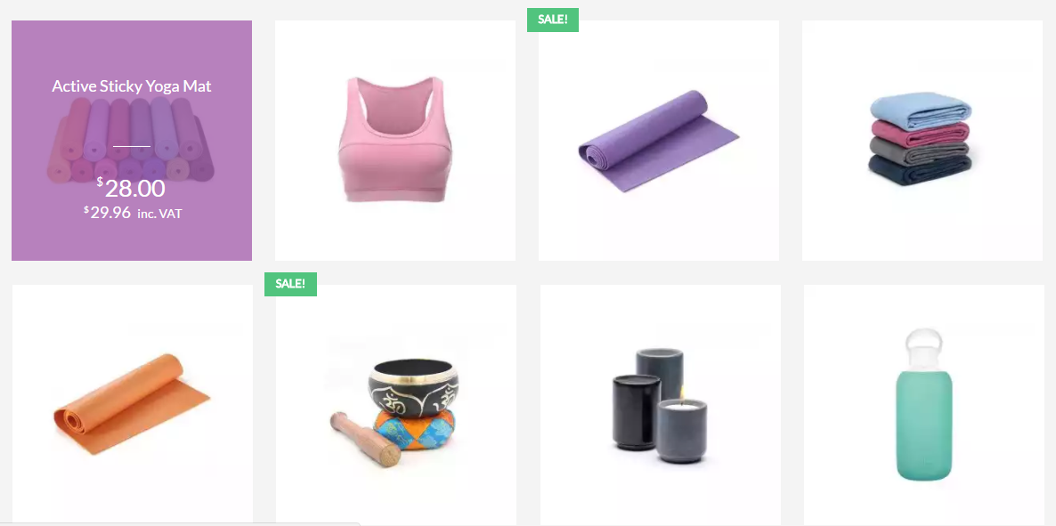
LOGO
Hi Name
Helfis Store

Slide 9
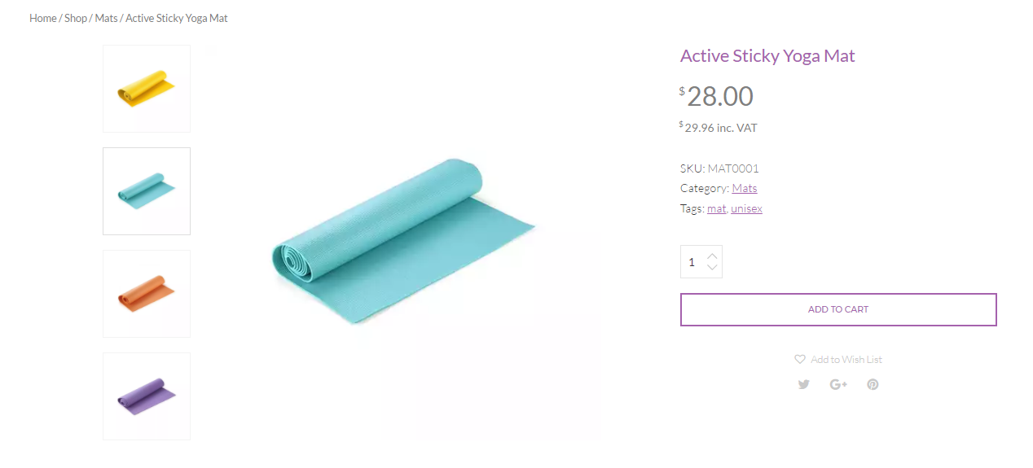
LOGO
Hi Name
Helfis Store

Slide 10
LOGO
Hi Name
Store Manager

Slide 11
LOGO
Hi Name
FAQs
What do you want to know?
Search
Ask the community Contact Us
In case the question is not listed
+ Q1.
+ Q2.
+ Q3.
+ Q4.

Slide 12
LOGO
Hi Name
Terms

Slide 13
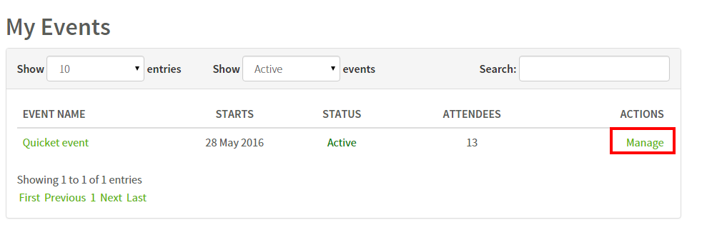
LOGO
Hi Name
Manage Events
Filters

Slide 14
LOGO
Hi Name
Create Event
All Day Event
Date
Time Slot
Venue
Event Name
Category
Sub-category
Teacher
Max. no. of entries
Other Information
Calendar Drop Down
One Hr. Time (e.g. 3pm-4pm
Venue
Event Name
Category Drop Down
Sub-category Drop Down
Name
Number (E.g. 10,20,25,30)
Create

Slide 15
LOGO
Hi Name
Company/HR Dashboard
Month/weekly
Engagement Graph (Monthly/Weekly)
Billing
Speedometer for no. of employees engaged vs. Total employees
Most searched/enrolled Activities
Best Performers
Pie chart for Traffic: Search Traffic, Referral Traffic, Direct Traffic, Campaigns

Slide 16
LOGO
Hi Name
Helfis Dashboard
Company
Group
Employee
Search
Drop Down
Drop Down
Drop Down
Name/User Id
Find
Monthly/weekly
Engagement Graph (Monthly/Weekly)
Speedometer for no. of employees engaged vs. Total employees
Most searched/enrolled Activities
No. of Visits:
Unique Visitors:
Pages per visit:
Avg. time on dashboard:
New Visits:
Pie chart for new and returning visitors
Best Performers
Pie chart for Traffic: Search Traffic, Referral Traffic, Direct Traffic, Campaigns

Slide 17
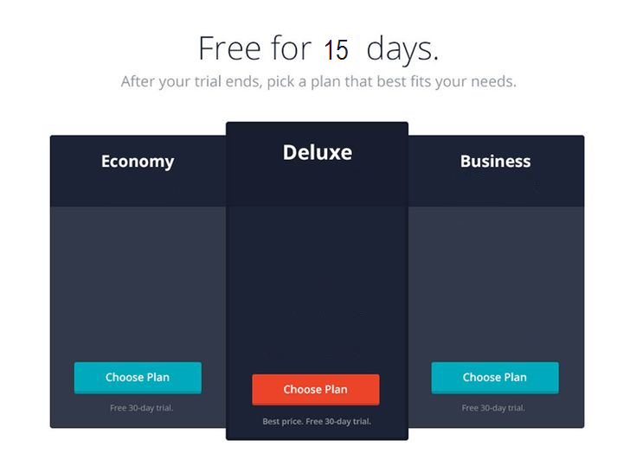
LOGO
Hi Name
Company Registration
Create a new account

Slide 18
LOGO
Hi Name
Company Registration
Company Name
Official Email Id
Phone Number
Enter Password
Re-enter Password
* Terms and conditions
Register

